Slide 1
GCC Atlas
A decision workspace
for India GCC setup
Arkapravo Ghosh · Product Intern assignment · 11 October 2026
Notes:
Product proposal. Desk research and a working prototype; no customer interviews or commercial validation have been completed.

Slide 2
The problem is a decision without comparable evidence
A new entrant must commit to a location and partners before it has a reliable way to compare them.
The decision
The fragmented inputs
The resulting friction
Where can we build the capability we need, at a cost we understand, with partners we can verify?
Company announcements, office reports, policy documents, recruitment estimates and referrals describe different slices of the ecosystem.
The buyer rebuilds the evidence in a spreadsheet, resolves conflicting definitions, and asks advisors to fill the gaps.
This is a synthesis of the assignment and desk research. The frequency and cost of this friction still need buyer interviews.
02 / GCC ATLAS
Notes:
Problem supplied in assignment. Inference, not measured customer behaviour. EY GCC Pulse Survey 2025 highlights talent and operating priorities: https://www.ey.com/en_in/insights/consulting/global-capability-centers/india-s-gccs-are-leading-the-shift-to-intelligent-ai-native-enterprises

Slide 3
The ecosystem has several information bottlenecks
Player | What they need | What they use today / likely consequence
Entrant CTO / COO | Comparable city and setup evidence | Advisors, referrals, reports → repeated diligence
GCC / HR leaders | Role-level hiring and capability data | Recruiters, peers → uneven salary / supply estimates
Advisors, lawyers, auditors | Reliable entity and project context | Filings, client records → manual reconciliation
Recruiters, EOR / payroll firms | Demand and operating requirements | Networks, job posts → weak project qualification
Real estate firms | Mandates, space demand and timing | Leasing data, relationships → partial demand visibility
States / investment agencies | Project eligibility and policy uptake | Applications, promotion → selective information
Stakeholder pain map = hypotheses to validate. Exposure to a fee or commercial incentive does not establish bias in any specific provider.
03 / GCC ATLAS
Notes:
Stakeholders drawn from assignment. Current workarounds and consequences are hypotheses based on desk synthesis, not primary interviews.

Slide 4
The numbers need a unit and a reporting period
1,700+
2,117
1,950+
GCCs · FY24
GCCs · FY26
“GCC units” · Dec 2024
Nasscom–Zinnov
2,975+ centres
Nasscom–Zinnov
3,728 units
JLL office report
Scope not reconciled
A later year can explain growth. A different definition can explain a different count. Atlas preserves both; it does not average them.
Nasscom (Sep 2024); Zinnov FY26 release (Jul 2026); JLL (Jan 2025).
04 / GCC ATLAS
Notes:
FY24 indexed Nasscom page: https://community.nasscom.in/communities/nasscom-insights/india-gcc-landscape-report-5-year-journey (direct fetch returned 406; indexed summary used). FY26 primary Zinnov release: https://www.prnewswire.com/in/news-releases/india-s-gccs-are-increasingly-leading-the-ai-mandate-for-global-enterprises-driving-global-value-creation-nasscom--zinnov-report-302817463.html . JLL: https://www.jll.com/en-in/newsroom/gccs-drive-record-77-2-mn-sqft-office-leasing-in-india . Do not treat their units as methodologically identical.

Slide 5
Small errors can matter more than cheaper office space
Illustrative 200-person GCC: ₹24 lakh annual salary per person, 70% seating, 100 sq ft per seat, ₹110 base rent / sq ft / month.
₹48 cr
₹2.4 cr
₹18.5 L
Annual salary budget
Effect of a 5% salary error
Saving from 10% lower rent
200 × ₹24 lakh
Excludes benefits and hiring
₹48 cr × 5%
Sensitivity, not observed loss
₹1.848 cr base rent × 10%
Same office assumptions
The product should make assumptions explicit and demand role-level talent evidence. A rent-only ranking would answer the wrong question.
05 / GCC ATLAS
Notes:
All inputs are illustrative author assumptions. Salary = 200 * 24 * 100000 = 480000000 INR. Area = 200 * .7 * 100 = 14000 sq ft. Rent = 14000 * 110 * 12 = 18480000 INR. 5% salary = 24000000 INR. 10% rent = 1848000 INR. Not a market salary or rent benchmark.

Slide 6
The first opportunity is a defensible location shortlist
Opportunity | Value / data feasibility | Priority and rationale
Location decision workspace | High decision stakes; some public precedents | 1 · First product, with explicit evidence gaps
Launch / expansion intelligence | Recurring value; public announcements | 2 · Adds freshness and repeat use
Provider delivery evidence | High trust value; public proof is thin | 3 · Build through consented references
Talent / effective cost benchmarks | Critical input; data needs partners | 4 · License / collect; do not invent
Full ecosystem marketplace | Broad demand; cold start and conflicts | Later · Requires verified supply and demand
Priority is an editorial judgment based on urgency, public-data feasibility and ability to test a specific buyer outcome.
06 / GCC ATLAS
Notes:
Prioritization is author judgment, not a numerical market survey. Provider delivery and talent information often require interviews, licenses or client consent beyond public documents.

Slide 7
The first buyer has an approved India mandate
Initial segment: a global mid-market company planning its first 100–500-person technology GCC, before signing a lease or appointing a setup partner.
User & buyer
Trigger
Job to be done
COO or transformation lead runs the comparison. CTO validates the capability. CFO signs the business case.
Leadership approves India exploration. The company has a mandate and a staffing plan but little local context.
Produce a three-city shortlist with evidence, cost assumptions and unresolved questions that leadership can review.
Entry point: the shortlist decision. Success means the buyer can explain why a city advances and what must still be verified.
07 / GCC ATLAS
Notes:
ICP, roles and trigger are explicit hypotheses. Sample scenario uses 200 staff; headcount range is a proposed target segment, not an established market distribution.

Slide 8
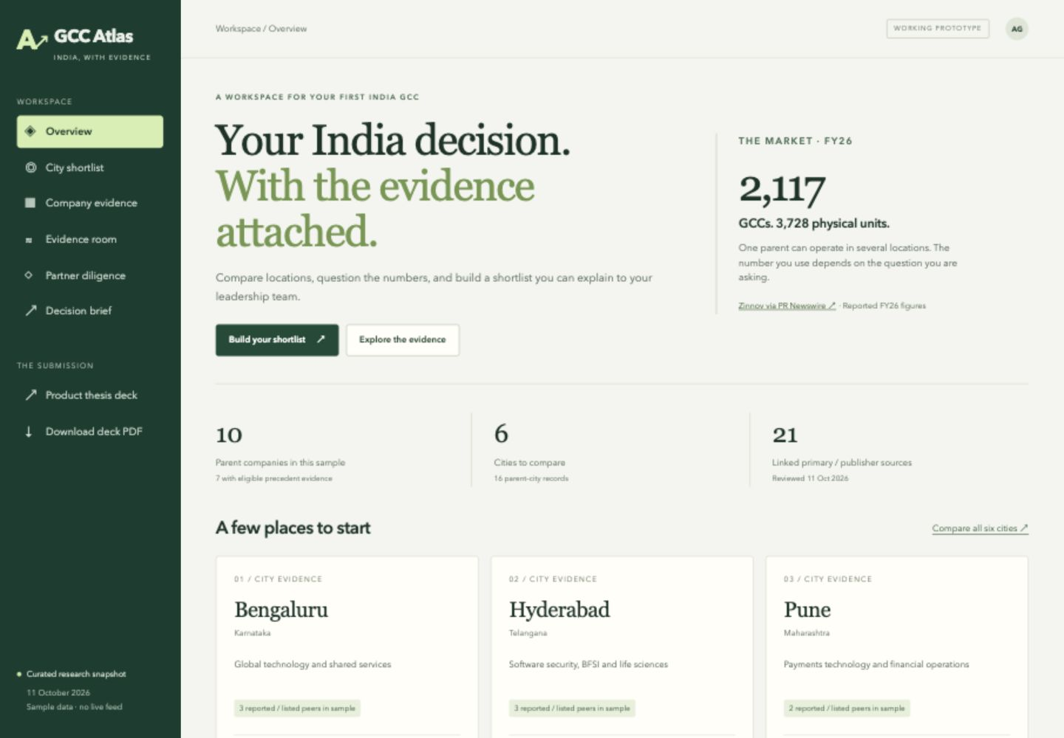
GCC Atlas: a working evidence workspace
A focused first release
6 cities
10 parent companies
16 parent–city records
21 linked sources
Compare a scenario, inspect evidence and export a brief.
Actual prototype screenshot · browser-tested desktop view
08 / GCC ATLAS
Notes:
Screenshot of authored local working prototype at http://127.0.0.1:4173. Counts from prototype/src/data.js. Seven parents meet the prototype precedent eligibility rule; three are retained with insufficient or old evidence.

Slide 9
The workflow produces a reviewable decision brief
01 Define the project
02 Challenge the shortlist
03 Carry the reasoning forward
Choose a mandate and sector. Enter headcount, salary and seating assumptions. Adjust peer versus cost weighting.
Compare six cities. Open each company’s source. Keep announcement-only or uncertain mandate evidence separate.
Save up to three cities. Add diligence questions. Export Markdown or project JSON; print a PDF.
Working today: ranking, keyword retrieval, database saves, optional accounts and export. Live crawling and runtime LLM generation remain outside the prototype.
09 / GCC ATLAS
Notes:
Feature claims reflect implemented app. Ranking uses matching eligible parent count within the sample and modeled annual salary + base rent. No city-specific talent benchmark is claimed.

Slide 10
Trust lives at the claim level
A primary source can establish one fact without establishing every fact on the same company profile.
Entity ≠ location
Announcement ≠ operation
Presence ≠ capability supply
One parent, multiple city records. Customer-facing offices are not automatically included as GCCs.
Vanguard’s 2024 plan is retained as announcement-only. The sample does not infer a later opening from the planned date.
Fidelity’s office listing confirms a location. It does not establish the captive mandate there or available talent.
Store source URL, publication period, access date, claim, evidence status and limitations. “Unknown” is a useful answer.
Vanguard company release (Dec 2024); Fidelity International office listing (undated).
10 / GCC ATLAS
Notes:
Vanguard source: https://externalcrewnet.vanguard.com/content/corporatesite/us/en/corp/who-we-are/pressroom/press-release-vanguard-announces-a-new-technology-office-in-hyderabad-india-121924.html . Fidelity source: https://careers.fidelityinternational.com/locations/india/offices/ . Prototype does not claim Vanguard is still unlaunched; it says the selected evidence is insufficient to verify subsequent opening.

Slide 11
Existing players already offer data and execution
Alternative | What it already does | Atlas’s proposed reason to switch / add
Nasscom / Zinnov reports | Market landscape and periodic research | Project-specific comparison with preserved scope
GCCPROs | Database, city atlas, verified-field claims | Shared decision history and unresolved claims
Scutiger tracker | Sourced launch / expansion tracking | Explicit assumptions and a buyer-owned brief
ANSR / Zinnov services | GCC setup, operations and transformation | Independent comparison before partner selection
Reports + spreadsheet | Flexible analysis with familiar tools | Evidence attached to each claim; less reassembly
Positioning: an evidence workspace for GCC setup decisions. Sourced rows alone are not a moat; workflow adoption and correction history must earn one.
11 / GCC ATLAS
Notes:
GCCPROs: https://www.gccpros.com/about . Scutiger: https://www.scutiger.com/gcc-tracker/ . ANSR: https://ansr.com/global-capability-center/ . Zinnov: https://zinnov.com/gcc-setup/ . Research report links in slide 4. No claim that these competitors cannot implement the proposed workflow.

Slide 12
Each stakeholder needs a different reason to return
Stakeholder | Reason to use Atlas | Contribution / commercial boundary
Entrant / GCC leader | One brief with assumptions and sources | Pays for decision workspace or diligence
Advisor / legal / audit | Reusable evidence with a review trail | Contributes corrections; can license workspace
Recruiter / payroll / EOR | Clear mandate and qualified requirements | Opt-in project access; no contact resale
Real estate firm | Named space requirements and timing | Shares current quotes with date and scope
Service provider | Documented relevant case evidence | Submits references; cannot buy rank
State / investment agency | Correct policy links and eligibility questions | Publishes official updates; no outcome scoring
The entrant comes first. Other stakeholders join when they make the buyer’s evidence more useful, not merely to increase listings.
12 / GCC ATLAS
Notes:
Stakeholder acquisition and contributions are a product proposal. No partnerships, integrations, user interviews or commercial agreements have been secured.

Slide 13
A paid decision project fits episodic demand
First distribution
Pricing tests
Repeat use
Recruit 5 entrant teams through GCC communities and independent advisors. Offer a scoped shortlist review using their actual mandate.
Test ₹50,000 per project for the workspace. Test ₹2 lakh for concierge diligence. Prices and willingness to pay are unvalidated.
After setup, expansion alerts and a reusable advisor workspace can support subscriptions. Keep referral commissions out of ranking.
Illustrative service scenario: 50 concierge projects × ₹2 lakh = ₹1 crore gross revenue, before delivery costs. This is not a TAM estimate or forecast.
13 / GCC ATLAS
Notes:
All pricing, conversion, volume and revenue are explicit hypotheses. The total GCC ecosystem revenue is not treated as addressable software revenue. Concierge gross-margin feasibility requires measuring analyst hours, licensing and acquisition costs.

Slide 14
AI accelerates extraction; review controls the claims
Proposed production pipeline. The one-day prototype uses AI-assisted research and a curated static snapshot.
01 Collect & extract
02 Resolve & review
03 Retrieve & explain
Monitor permitted public sources. Capture date and document version. Use a schema-guided model to extract claims with source spans.
Link parent, subsidiary and location. Flag conflicts and duplicate announcements. A reviewer approves identity and operating status.
Retrieve approved evidence for a project. Calculate costs in code. Generate a brief with citations and abstain when support is missing.
Start with 50 double-reviewed records. Evaluate identity matches, source support and announcement/operation errors before expanding coverage.
14 / GCC ATLAS
Notes:
Production design proposal; not implemented integrations. Prototype uses deterministic keyword search and calculations, no runtime LLM. Source licensing and site terms must be assessed before ongoing ingestion. Claims retain effective period and observed date; revisions form correction history.

Slide 15
The next 30 days should test value before scale
Test | Success threshold (proposed) | Decision if it fails
10 discovery interviews | Recurring shortlist pain in ≥6; exact workaround recorded | Narrow the buyer or problem
5 project walkthroughs | ≥4 finish a sourced shortlist in 15 minutes | Simplify workflow / missing evidence
3 paid concierge pilots | ≥2 pay; contribution margin positive | Revisit pricing and service scope
50-record blind audit | ≥95% fields supported; zero false operating-status promotions | Fix evidence rules before ingestion
Provider reference trial | Consent-based scope / outcomes for 5 cases | Defer delivery ratings
North-star hypothesis: approved project shortlists whose key claims are supported and whose open questions are explicit. No interviews or pilots have run yet.
15 / GCC ATLAS
Notes:
Thresholds are author-proposed decision gates, not reported results. Interview outreach is not part of this completed assignment and no messages were sent. Customer validation has not occurred.

Slide 16
One day of execution, with a deliberate scope
Built
Research boundary
AI disclosure
Responsive evidence workspace, scenario comparison, company filters, source ledger, partner check plan and exportable brief.
Company and publisher evidence with original links. Small sample; no audited census, salary dataset, verified provider outcomes or automatic refresh.
AI supported research, idea critique, initial schema, code and deck creation. Deterministic retrieval and scoring run in the app; no runtime LLM.
Human judgment retained: the first buyer, exclusions, source interpretation, commercial neutrality and what the prototype must not claim.
16 / GCC ATLAS
Notes:
AI used extensively during this session to research and build. No fabricated user interviews, performance reviews or private source data. Browser review and tests are recorded separately in outputs/Validation-Report.md.

Slide 17
Try one location decision
1 Open City shortlist and choose Engineering.
2 Switch to Operations / BFSI; inspect the changed peers.
3 Inspect Fidelity or Vanguard in Company evidence.
4 Search “GCC units” in Evidence room.
5 Save three cities and download the decision brief.
Open the prototype ↗
gcc-atlas.arkapravo.in
The core product promise: the reviewer can inspect the evidence behind the decision and see what is still unknown.
17 / GCC ATLAS
Notes:
Prototype: https://gcc-atlas.arkapravo.in . Deck: https://gcc-atlas.arkapravo.in/deck.html . PDF: https://gcc-atlas.arkapravo.in/GCC-Atlas-Deck.pdf . All cost inputs remain illustrative. Demo projects stay in the visiting browser; optional accounts continue across devices.

Slide 18
Research references
Primary company, government and publisher sources. Full source ledger is available in the prototype; citations also appear in speaker notes.
Nasscom–Zinnov · FY26 release
Government of Karnataka · GCC policy portal
Nasscom · FY24 landscape (indexed summary; direct fetch blocked)
Invest UP · GCC implementation rules
JLL · 2024 GCC office demand
GCCPROs · Database / atlas description
CBRE · India Office Figures Q4 2025
Scutiger · Sourced GCC tracker
EY · GCC Pulse 2025
ANSR / Zinnov · GCC setup services
Full source ledger ↗
Research date: 11 October 2026. Sources establish their stated claims; they do not constitute independent verification of delivery or current staffing.
18 / GCC ATLAS
Notes:
All source URLs in prototype/src/data.js and outputs/Research-Ledger.md. Company evidence includes Sonatype, Vanguard, Sanofi, Mastercard, BNY, NatWest, JPMorganChase, Tesco, Walmart and Fidelity International. Publication dates may be unknown; access dates are not freshness guarantees.
Nasscom–Zinnov · FY26 release: https://www.prnewswire.com/in/news-releases/india-s-gccs-are-increasingly-leading-the-ai-mandate-for-global-enterprises-driving-global-value-creation-nasscom--zinnov-report-302817463.html
Nasscom · FY24 landscape (indexed summary; direct fetch blocked): https://community.nasscom.in/communities/nasscom-insights/india-gcc-landscape-report-5-year-journey
JLL · 2024 GCC office demand: https://www.jll.com/en-in/newsroom/gccs-drive-record-77-2-mn-sqft-office-leasing-in-india
CBRE · India Office Figures Q4 2025: https://www.cbre.com/insights/figures/india-office-figures-q4-2025
EY · GCC Pulse 2025: https://www.ey.com/en_in/insights/consulting/global-capability-centers/india-s-gccs-are-leading-the-shift-to-intelligent-ai-native-enterprises
Government of Karnataka · GCC policy portal: https://registration.eitbt.karnataka.gov.in/gcc/register
Invest UP · GCC implementation rules: https://invest.up.gov.in/wp-content/uploads/2026/03/GCC-SOP_140326.pdf
GCCPROs · Database / atlas description: https://www.gccpros.com/about
Scutiger · Sourced GCC tracker: https://www.scutiger.com/gcc-tracker/
ANSR / Zinnov · GCC setup services: https://ansr.com/global-capability-center/

